Slide 1

Create Environment
Train the module
Print unique values
Derive new feature using year to (age)
Use get_dummies to change to the values
Module set up using RandomForestRegression
Find the correlation using .corr()
Visualize using Seaborn, pairplot()
Use Heatmap to visualize better
Test train
Create X & Y variables
Find the important features
Use RandomizedSearcCV
Create a Random Grid
Predictions

Slide 2
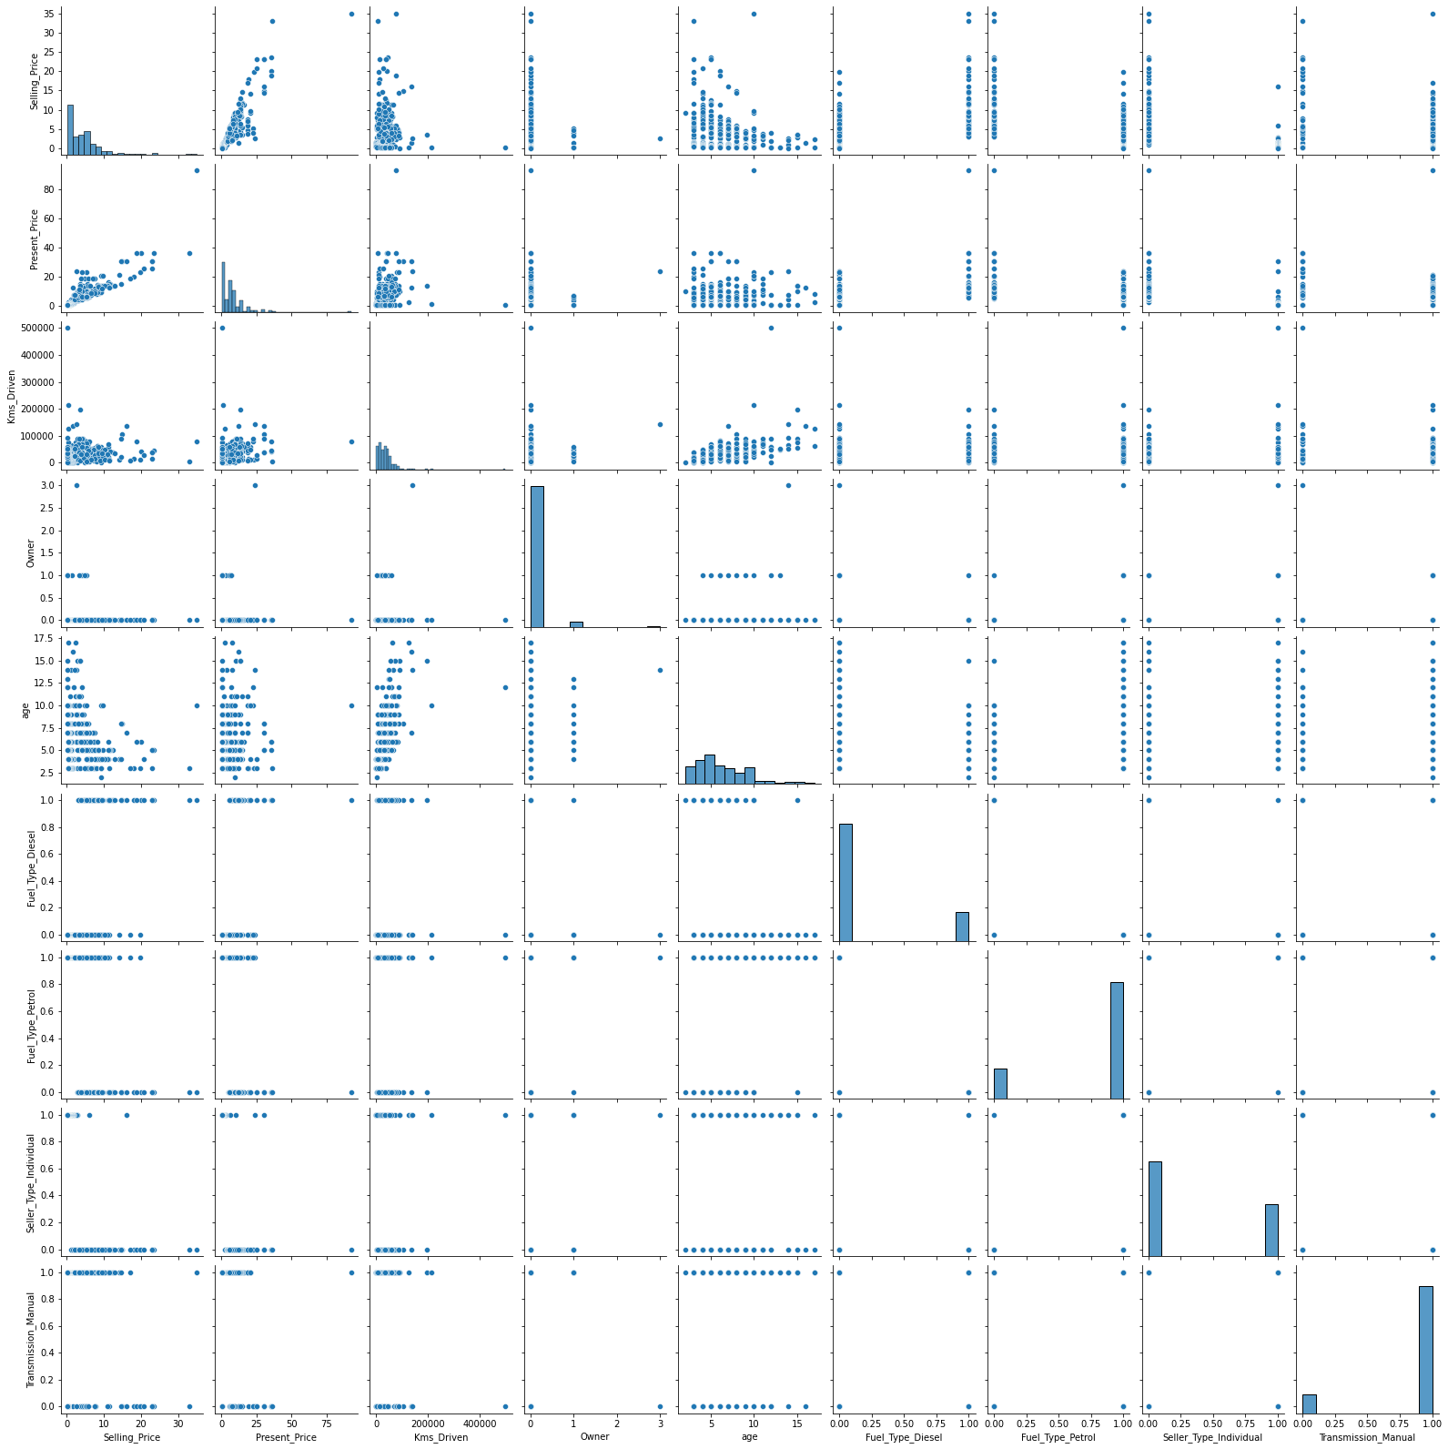
Correlation using Seaborn

Slide 3
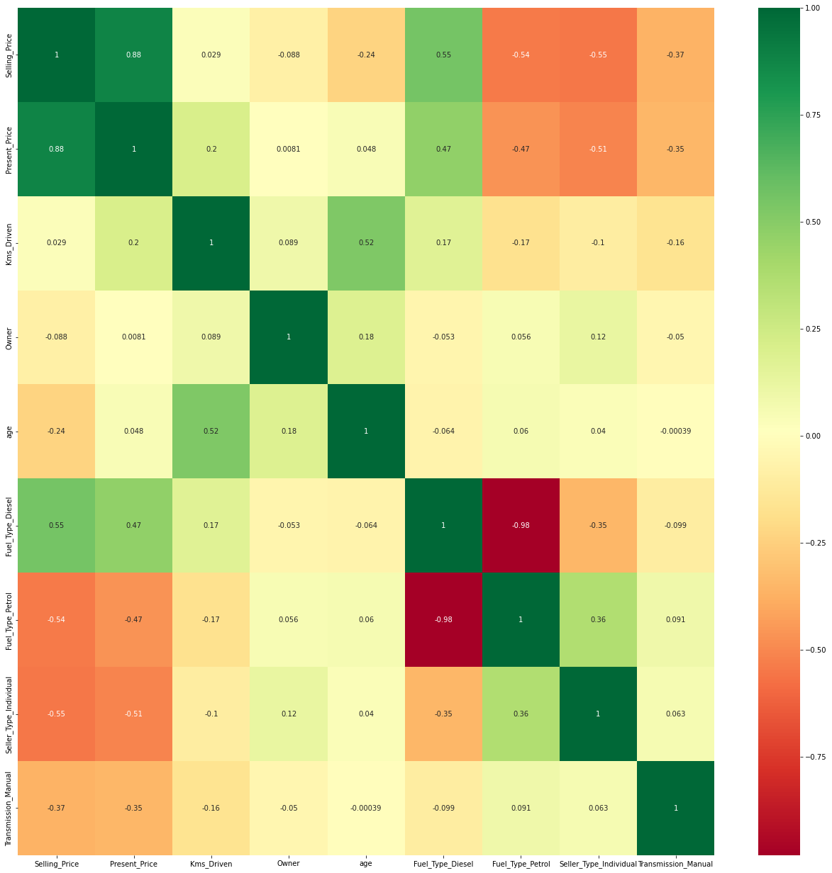
Heat Map

Slide 4
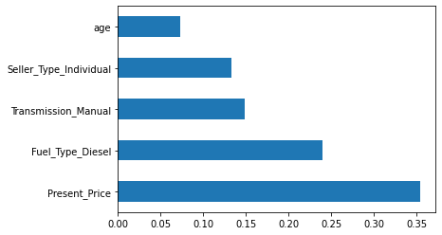
Important Features

